Slide 1
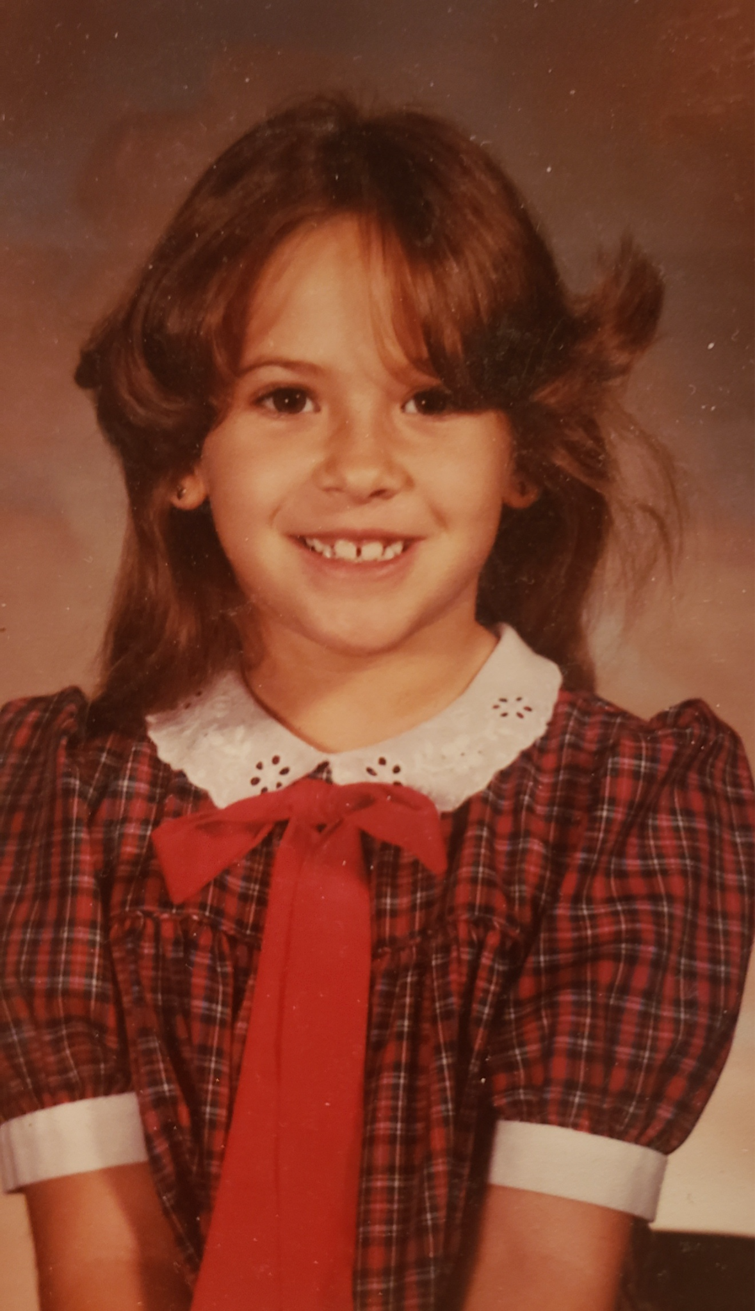
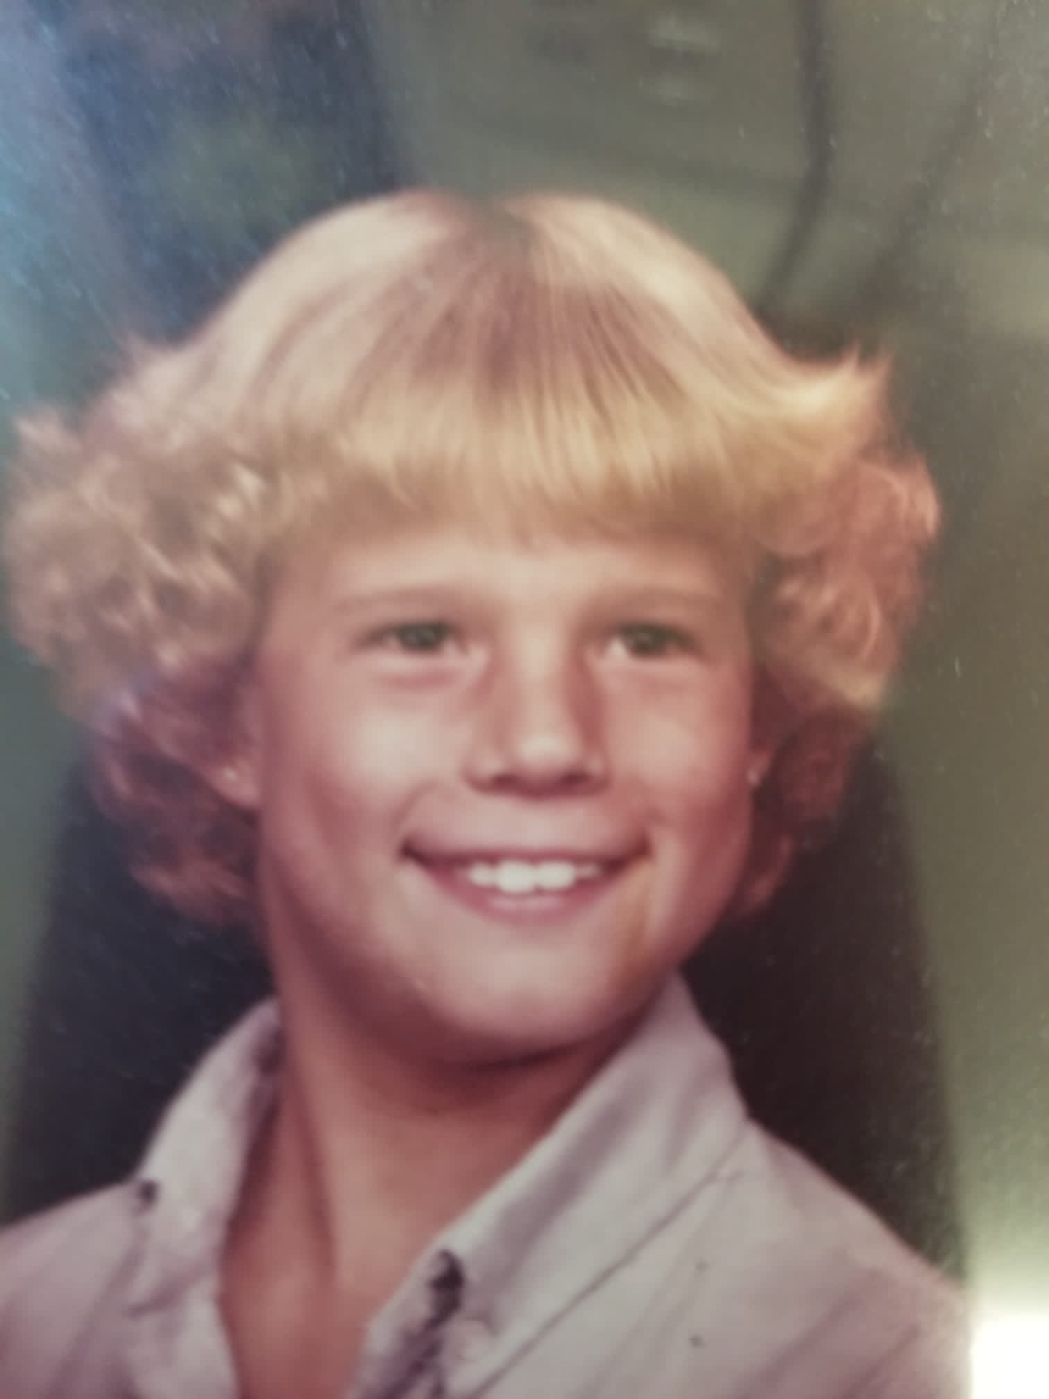
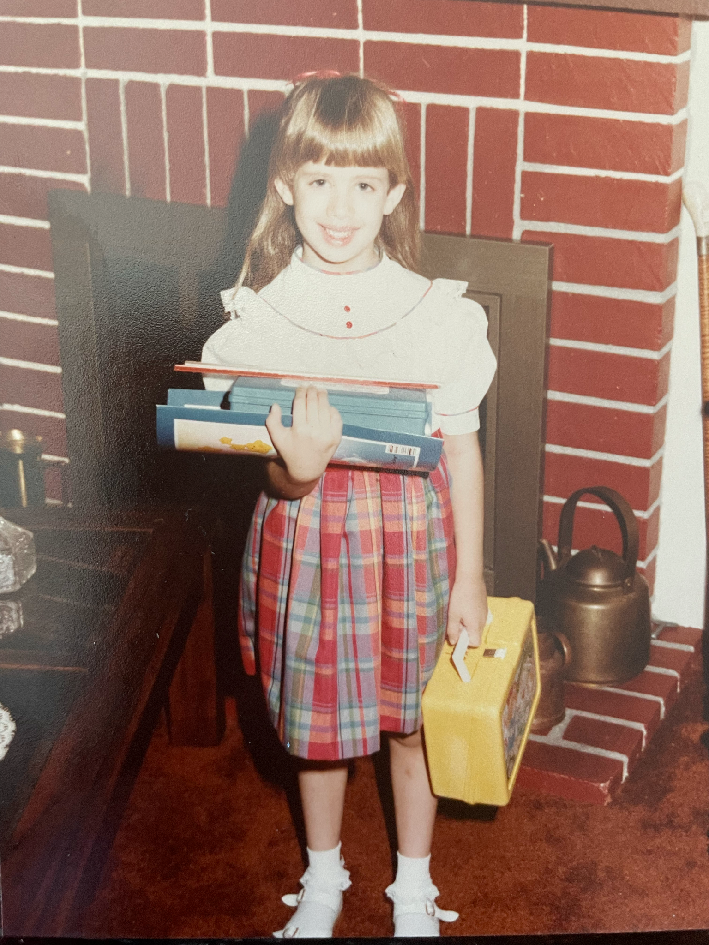
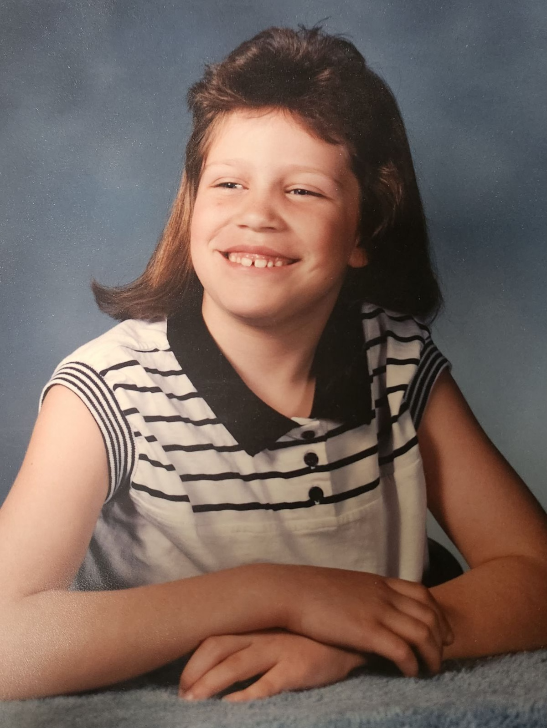
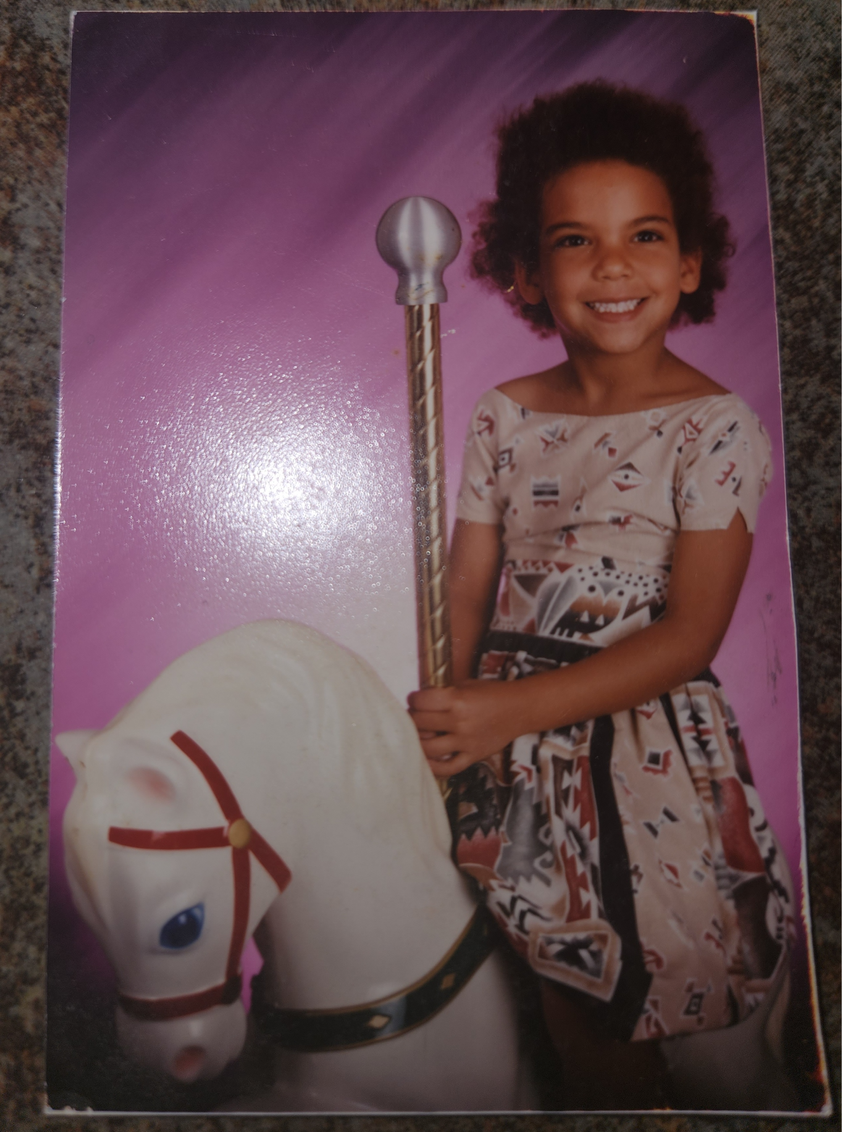
PTO Board Members
fvv
Chrissy Herrera
Co-President
Kate Price
Co-President
Shannon Sareen
Vice President
Megan George
Treasurer
Tammy Osbourn
Secretary

